Slide 1
Final project – Diabetes data set
Paul Draper
Hung (Tom) Nguyen
Ramya Meduri

Slide 2

AGENDA
Overview of the presentation
EDA & Data Cleaning
Model Building
Key Findings and Recommendations
Q & A

Slide 3
OVERVIEW OF THE Dataset: diabetes SOURCE: CDC 2015
Comprehensive dataset with factors hypothesized to be associated with risks of diabetes
Survey of 21 health and lifestyle-related attributes with 70,692 responses
Categorical features:
Yes or No: High BP, High Cholesterol, Cholesterol Check, Smoker,…
Multi-factor: Age, General Health, Education, Income
Numeric features: BMI, Mental Health, Physical Health
Target variable: Diabetes_binary (0 for No, 1 for Yes)

Slide 4
OVERVIEW OF THE Dataset: diabetes CONTD....
Diabetes_binary | 2 distinct values
HighBP | 2 distinct values
HighChol | 2 distinct values
CholCheck | 2 distinct values
BMI | 80 distinct values
Smoker | 2 distinct values
Stroke | 2 distinct values
HeartDiseaseorAttack | 2 distinct values
PhysActivity | 2 distinct values
Fruits | 2 distinct values
Veggies | 2 distinct values
HvyAlcoholConsump | 2 distinct values
AnyHealthcare | 2 distinct values
NoDocbcCost | 2 distinct values
GenHlth | 5 distinct values
MentHlth | 31 distinct values
PhysHlth | 31 distinct values
DiffWalk | 2 distinct values
Sex | 2 distinct values
Age | 13 distinct values
Education | 6 distinct values
Income | 8 distinct values
Aim of the analysis - The analysis aims to explore various health-related factors and their interconnections to accurately classify diabetes.
Outcome - Research can delve into the interactions among these variables and their impact on the occurrence and progression of diabetes. This knowledge is essential for improving patient care and achieving better outcomes in the ever-evolving field of healthcare.

Slide 5

Data Cleaning & EDA
Data Loading
Data cleaning/preprocessing: missing values, duplicates, outlier detection
Summary statistics of the data
Variable relationships
Visualize the distribution of data: age, income, BMI, blood pressure, high cholesterol, etc. among survey respondents.

Slide 6

DATA CLEANING
Data cleaning was performed, and the following observations were made:
Missing values: 0
2. Duplicates: 1635 - We retained the duplicate values considering the size of our dataset, which comprises responses from over 70,000 individuals. There is a high probability that some individuals have similar characteristics, justifying the presence of duplicates.
3. Check for outliers in numeric continuous variable
BMI: 2180 outliers (~3% of data)
Mental Health: 11816 (~16% of data)
Physical Health: 10624 (~15% of data)
Not to remove them because of potential importance to the model

Slide 7
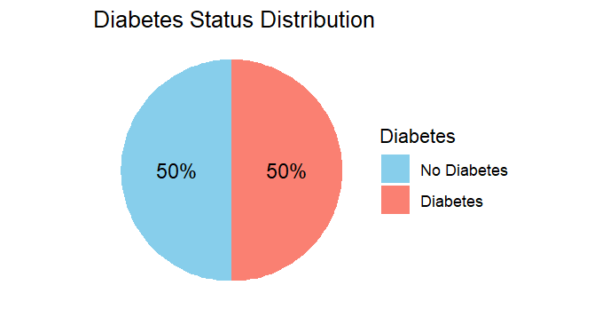
EXPLORATORY DATA ANALYSIS
Male - Female : 45.7% - 54.3%
Most frequent responses
Age range: 65 – 69
BMI – 27
Education – Higher education
Income – 75k +

Slide 8
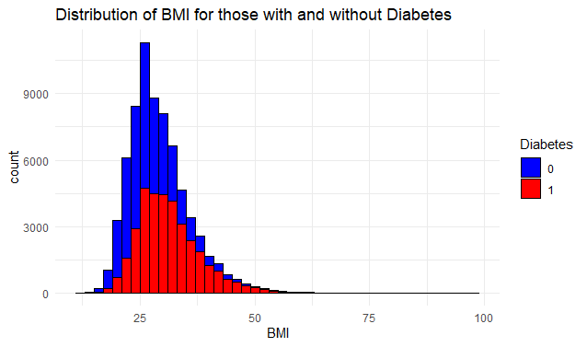
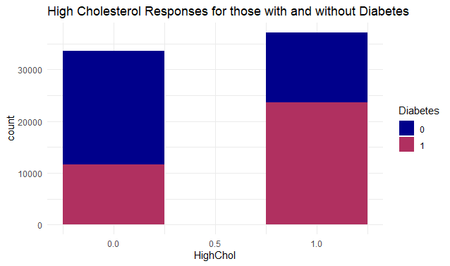
variables & diabetes diagnosis – BMI and CHOLESTEROL

Slide 9
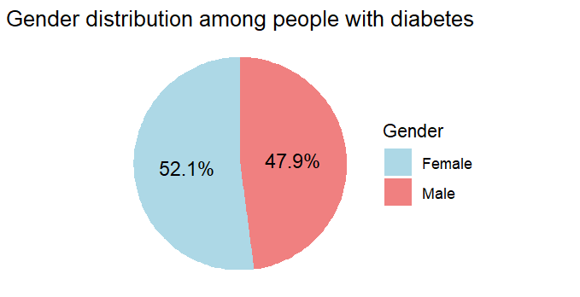
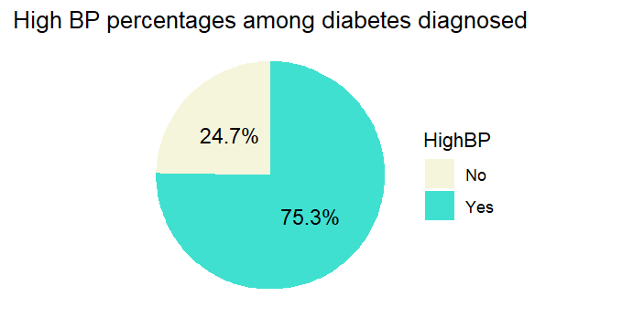
Features & diabetic People
GENDER & BLOOD PRESSURE

Slide 10
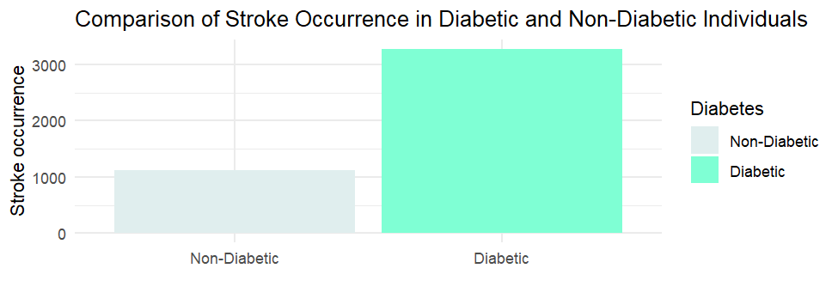
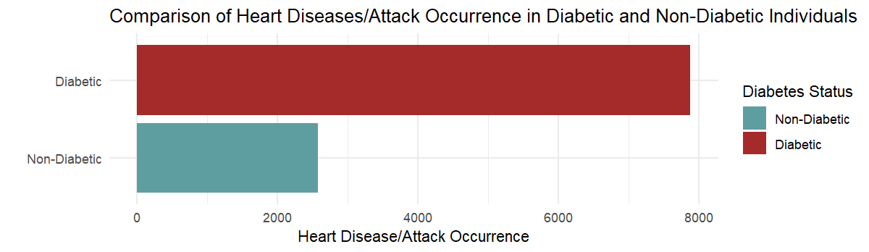
STROKE & HEART DISEASES

Slide 11
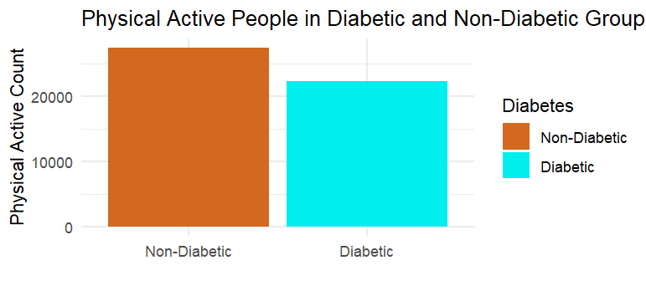
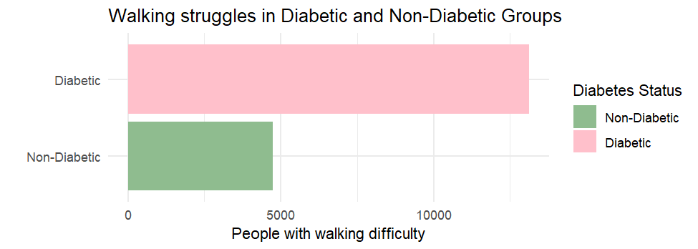
Physical activity, Difficulty walking

Slide 12
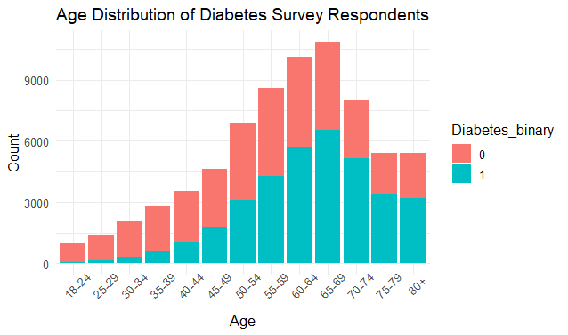
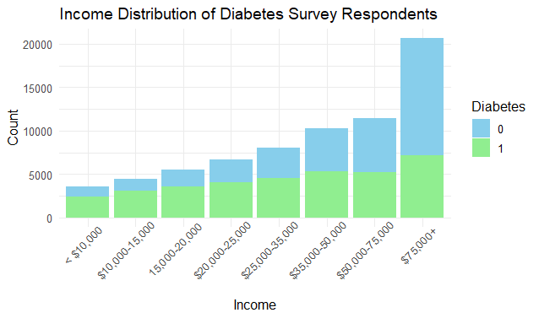
Age groups and income levels

Slide 13

Model building
Model Preparation
Assumptions of Logistic Regression
Initial Model Development
Variable Selection and Refinement
Model Evaluation
Model Comparison

Slide 14
Model Preparation
Encode/transform variables in preparation of model building
Data consisted of binary (0 or 1) variables and other categorical responses that needed to be converted to factors
BMI, Poor Physical Health Days, and Poor Mental Health Days left as numeric
Splitting data into test and training sets
Data was split using 80% of the data as our training data set and remaining 20% as our test set
R Packages loaded
Examples include Caret, leaps, glmnet, bestglm, MASS, randomForest

Slide 15
Assumptions of Logistic Regression
Response variable is binary
The observations must be independent.
There must be no perfect multicollinearity among independent variables. - VIFs < 5
Continuous predictors are linearly related to a transformed version of the outcome

Slide 16
Initial Model Development and Variable Selection
Started with GLM model using binomial distribution for all variables using 5 fold cross validation
Using functions such as regsubsets(), bestglm(), stepAIC() and varIMP() to further refine and identify influential factors in the model
Used several more advanced modeling approaches including K Nearest Neighbor (used both "class" and "caret" packages to compare), Lasso Regression, and Random Forest to compare performance

Slide 17
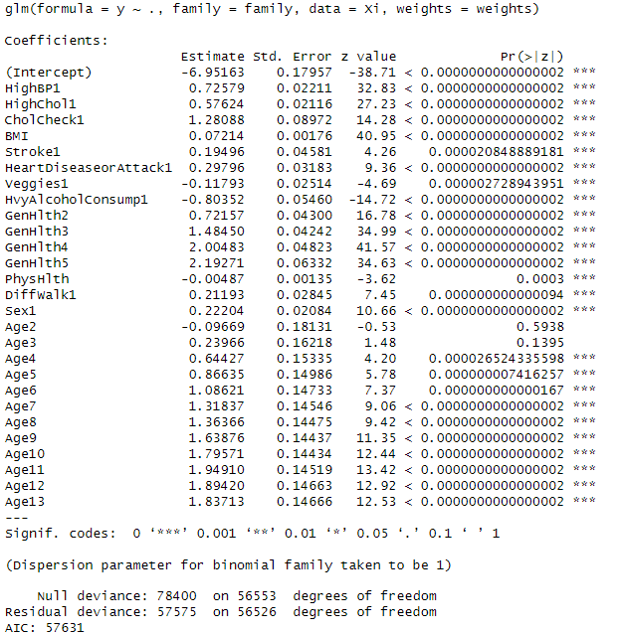
Final Model
High Blood Pressure
High Cholesterol
Cholesterol Check in the last 5 years
BMI
History of Stroke
History of Coronary Heart Disease or Myocardial Infarction (heart attack)
Daily Vegetable consumption
Heavy Drinker
General Health Score (1-5)
Days of Physical Activity over the last month
Serious Difficulty Walking
Sex
Age

Slide 18


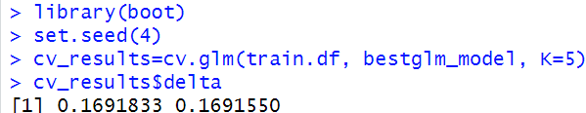
Model Evaluation
Cross validation
Independent variable vs Log odds of response
Pearson/Partial Residuals
Cross validation
AIC
Confusion Matrix
Accuracy
Precision
Recall
ROC Curve
Full model
Remove 'Age'
On final model

Slide 19
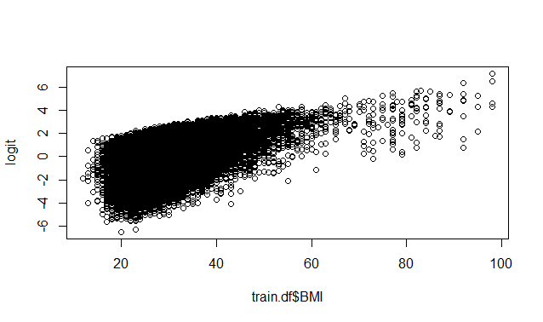
LOg odds vs BMI – Looking for Linearity

Slide 20
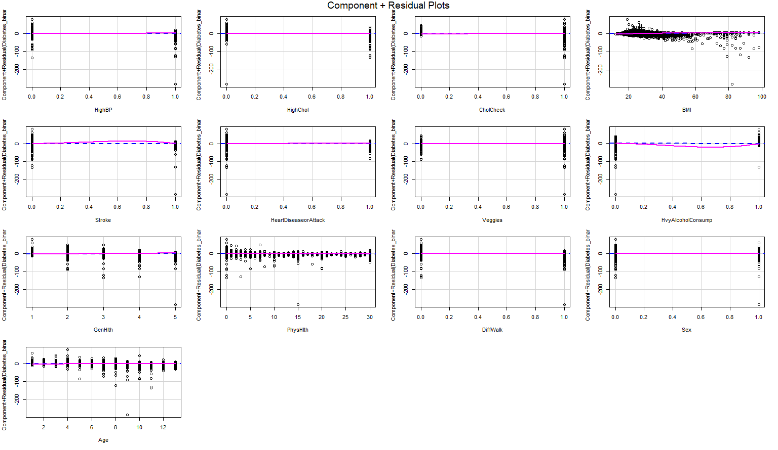

Slide 21
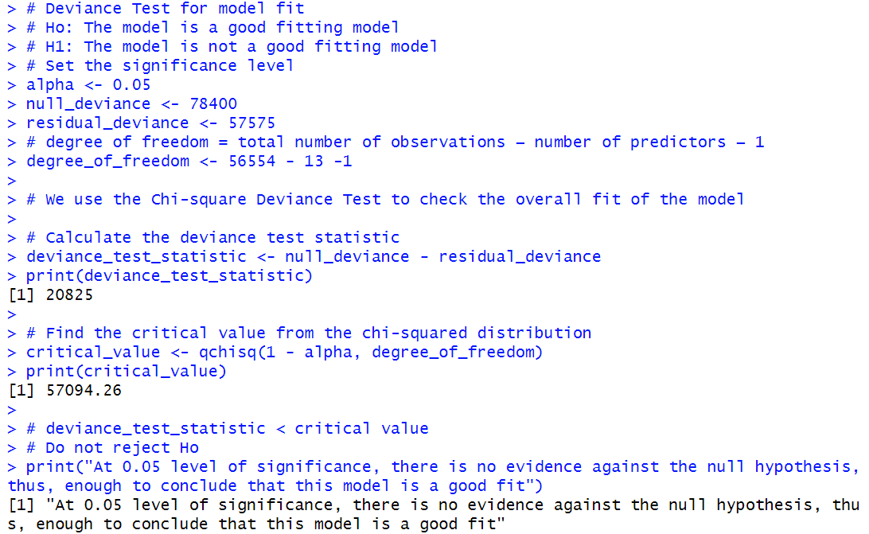
Deviance test

Slide 22
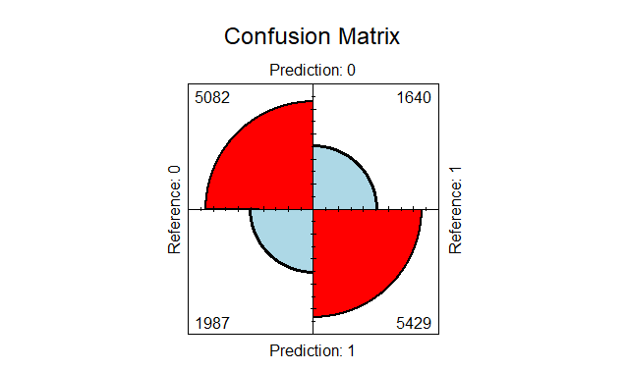
Model Accuracy
Accuracy: 74.3%
Precision: 73.2%
Recall: 76.8%
Precision - the number of true positives divided by the number of true positives plus the number of false positives.
Recall- the number of true positives divided by the number of true positives plus the number of false negatives.

Slide 23
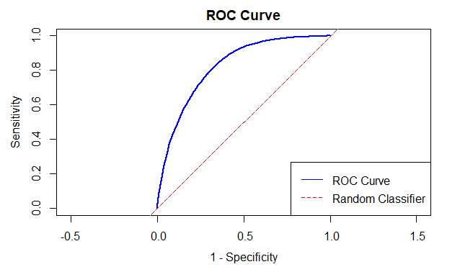
ROC Curve
Represents the True Positive Rate (y-axis) vs the False Positive Rate(x-axis). Used for model evaluation and the impact of criteria/threshold changes.

Slide 24
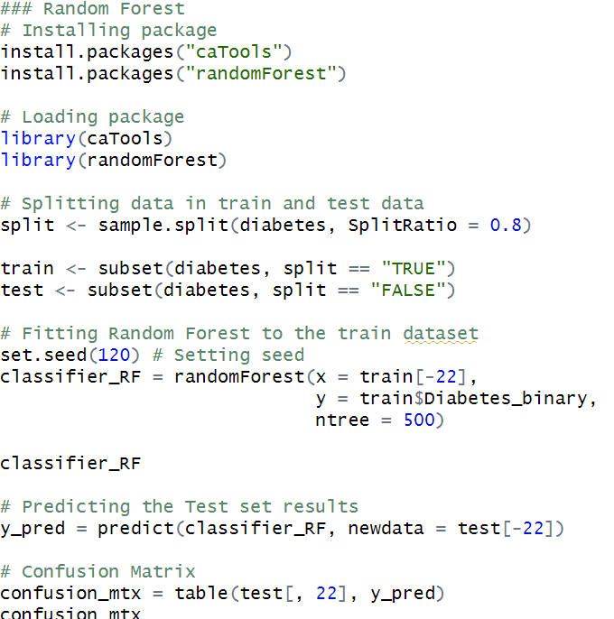

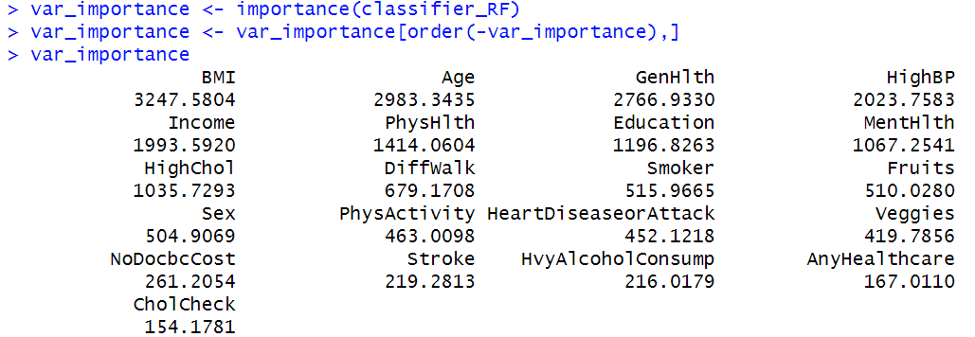
RANDOM FOREST
Accuracy: ~ 75.01%
Precision: ~ 72.97%
Recall: ~ 79.58%

Slide 25
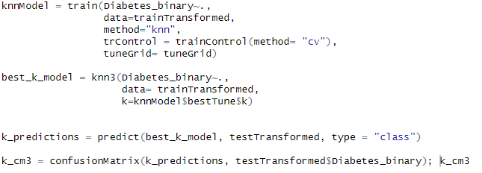
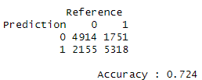
K Nearest Neighbor

Slide 26
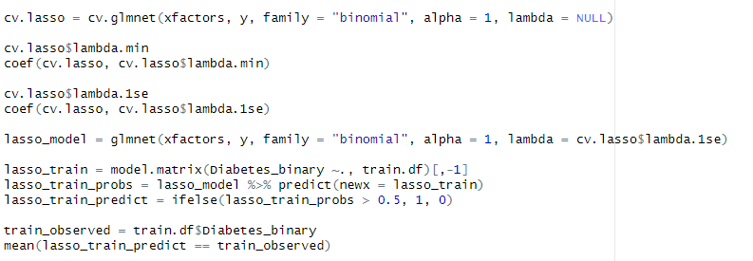
Lasso Regression
73% Prediction Accuracy

Slide 27
Key Findings and Recommendations
BMI, General Health Score, High Blood Pressure, and High Cholesterol were the most important predictors for determining Diabetes Risk
Non health related factors such as Income and Education do not make good predictors of Diabetes
There are limitations to our data but the model proved to be useful in identifying diabetes. However, there are additional unknown factors that the model is missing to more accurately identify Diabetes.
Additional survey questions on family history and diet would be recommended
Research shows that implementing more clinical predictors like triglycerides and glucose levels could also potentially improve Diabetes predictions
Explore further feature engineering techniques to improve model performance

Slide 28

Q & A

